Slide 1
Notes:
Topics:
Designing a Program
Input, Processing, and Output
Displaying Output with print Function
Comments
Variables
Reading Input from the Keyboard
Performing Calculations
More About Data Output
Named Constants
Introduction to Turtle Graphics

Slide 2
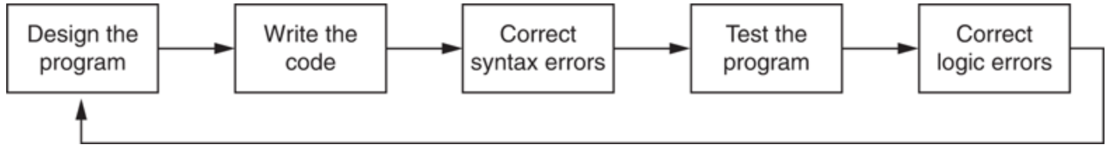
Designing a Program
Programs must be designed before they are written
Program development cycle:
Notes:
During the design process, programmers use tools such as pseudocode and flowcharts to create models of programs.

Slide 3
Designing a Program (cont’d.)
Design is the most important part of the program development cycle
Understand the task that the program is to perform
Create one or more software requirements
Determine the steps that must be taken to perform the task
Break down required task into a series of steps
Create an algorithm, listing logical steps that must be taken
Notes:
Work with customer to get a sense what the program is supposed to do and ask questions about program details

Slide 4
Designing a Program (cont’d.)
Algorithm: set of well-defined logical steps that must be taken to perform a task
Example: calculate and display gross pay for an hourly paid employee
1. Get the number of hours worked.
2. Get the hourly pay rate.
3. Multiply the number of hours worked by the hourly pay rate.
4. Display the result of the calculation that was performed in step 3.
Notes:
*** Give in-class example of algorithm of throwing paper into trash can ***
Have student or instructor act as robot following directions from students to pick up piece of paper and walk steps to drop it in the trash can. Record steps on board.
Of course, this algorithm isn’t ready to be executed on the computer. The steps in this list have to be translated into code. Programmers commonly use two tools to help them accomplish this: pseudocode and flowcharts.

Slide 5
Pseudocode
Pseudocode: fake code
Informal language that has no syntax rule
Not meant to be compiled or executed
Used to create model program
Can be translated directly into actual code in any programming language
Example: pay calculating program
Input the hours worked
Input the hourly pay rate
Calculate gross pay as hours worked multiplied by pay rate
Display the gross pay
Notes:
No need to worry about syntax errors, can focus on program’s design.
Each statement in the pseudocode represents an operation that can be performed in Python. For example, Python can read input that is typed on the keyboard, perform mathematical calculations, and display messages on the screen.

Slide 6
Flowcharts
Flowchart: diagram that graphically depicts the steps in a program
Ovals are terminal symbols
Parallelograms are input and output symbols
Rectangles are processing symbols
Symbols are connected by arrows that represent the flow of the program
Notes:
Flowcharting is another tool that programmers use to design programs.

Slide 7
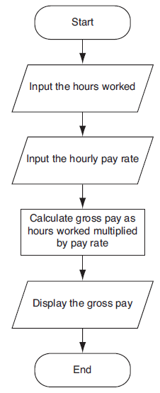

Slide 8
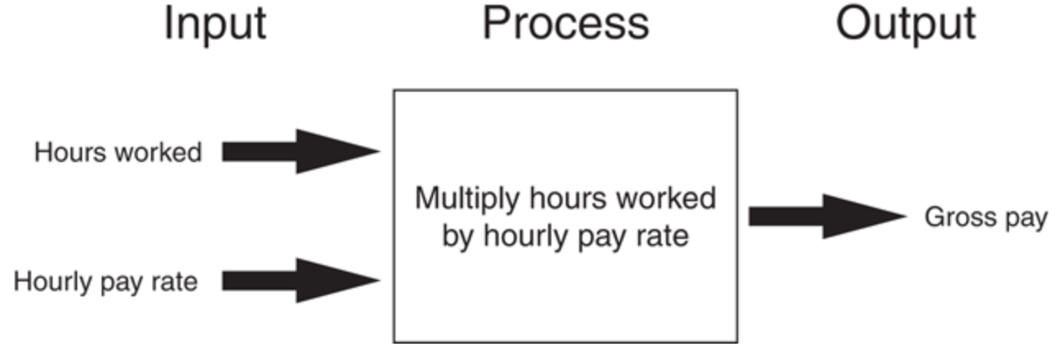
Input, Processing, and Output
Typically, computer performs three-step process
Receive input
Input: any data that the program receives while it is running
Perform some process on the input
Example: mathematical calculation
Produce output

Slide 9
Displaying Output with the print Function
Function: piece of prewritten code that performs an operation
print function: displays output on the screen
Argument: data given to a function
Example: data that is printed to screen
Statements in a program execute in the order that they appear
From top to bottom

Slide 10
Strings and String Literals
String: sequence of characters that is used as data
String literal: string that appears in actual code of a program
Must be enclosed in single (') or double (") quote marks
String literal can be enclosed in triple quotes (''' or """)
Enclosed string can contain both single and double quotes and can have multiple lines
Notes:
If you want a string literal to contain either a single-quote or an apostrophe as part of the string, you can enclose the string literal in double-quote marks. Ex: print("Don't fear!")
Likewise, you can use single-quote marks to enclose a string literal that contains double-quotes as part of the string. Ex: print('Your assignment is to read "Hamlet" by tomorrow.’)
Triple-quoted strings can contain both single quotes and double quotes as part of the string. Ex: print("""I'm reading "Hamlet" tonight.""")
Triple quotes can also be used to surround multiline strings, something for which single and double quotes cannot be used.
Ex: print("""One
Two
Three""")

Slide 11
Comments
Comments: notes of explanation within a program
Ignored by Python interpreter
Intended for a person reading the program’s code
Begin with a # character
End-line comment: appears at the end of a line of code
Typically explains the purpose of that line
Notes:
End-line comment example:
print(‘Hello’) # Print greeting

Slide 12

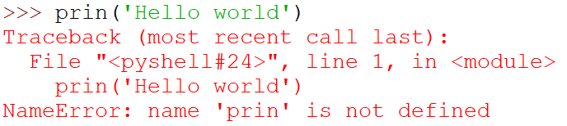
Error Messages and Debugging
There are different types of errors
Example 1:
Example 2:

Slide 13
Variables
Variable: name that represents a value stored in the computer memory
Used to access and manipulate data stored in memory
A variable references the value it represents
Assignment statement: used to create a variable and make it reference data
General format is variable = expression
Example: age = 29
Assignment operator: the equal sign (=)

Slide 14
Variables (cont’d.)
In assignment statement, variable receiving value must be on left side
A variable can be passed as an argument to a function
Variable name should not be enclosed in quote marks
You can only use a variable if a value is assigned to it
Notes:
greeting = ‘Hello’
print(greeting)

Slide 15
Variable Naming Rules
Rules for naming variables in Python:
Variable name cannot be a Python key word
Variable name cannot contain spaces
First character must be a letter or an underscore
After first character may use letters, digits, or underscores
Variable names are case sensitive
Variable name should reflect its use
Notes:
The first character must be one of the letters a through z, A through Z, or an underscore character (_).
After the first character you may use the letters a through z or A through Z, the digits 0 through 9, or underscores.
Uppercase and lowercase characters are distinct. This means the variable name ItemsOrdered is not the same as itemsordered.

Slide 16
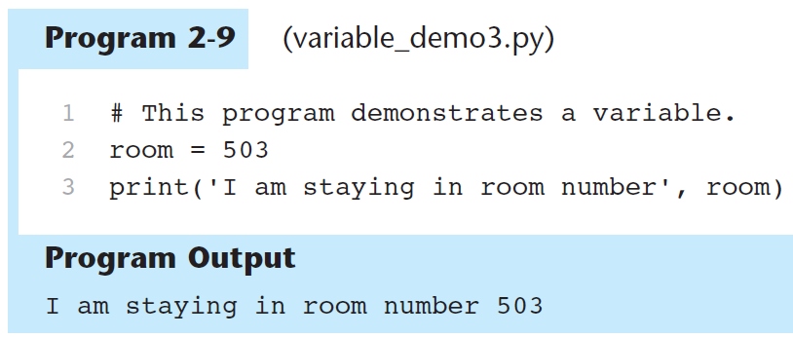
Displaying Multiple Items with the print Function
Python allows one to display multiple items with a single call to print
Items are separated by commas when passed as arguments
Arguments displayed in the order they are passed to the function
Items are automatically separated by a space when displayed on screen

Slide 17
Variable Reassignment
Variables can reference different values while program is running
Garbage collection: removal of values that are no longer referenced by variables
Carried out by Python interpreter
A variable can refer to item of any type
Variable that has been assigned to one type can be reassigned to another type

Slide 18
Numeric Data Types, Literals, and the str Data Type
Data types: categorize value in memory
e.g., int for integer, float for real number, str used for storing strings in memory
Numeric literal: number written in a program
No decimal point considered int, otherwise, considered float
Some operations behave differently depending on data type

Slide 19
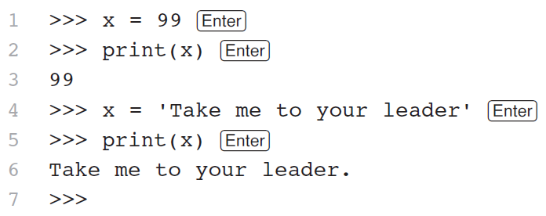
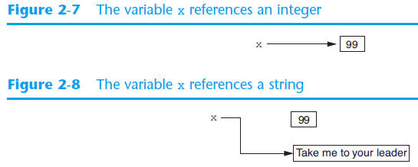
Reassigning a Variable to a Different Type
A variable in Python can refer to items of any type

Slide 20
Knowledge Check
1. What is the output?
dollars = 55.39
print(‘I have’, ‘dollars’)
2. What is the output?
greeting = ‘Hello’
greeting = ‘Hey’
print(greeting)
3. Which of the following are illegal variable names in Python? Why?
num2
phone#
my_grade
myGrade
my grade
50cent
Notes:
I have dollars
Hey
phone# → because of # symbol, my grade → because there’s a space, 50cent → because variable begins with a number

Slide 21
Reading Input from the Keyboard
Most programs need to read input from the user
Built-in input function reads input from keyboard
Returns the data as a string
Format: variable = input(prompt)
prompt is typically a string instructing user to enter a value
Ex:
Does not automatically display a space after the prompt

Slide 22
Reading Numbers with the input Function
input function always returns a string
Built-in functions convert between data types
int(item) converts item to an int
float(item) converts item to a float
Ex:
Nested function call: general format: function1(function2(argument))
Ex:
Type conversion only works if item is valid numeric value, otherwise, throws exception
Notes:
Value returned by function2 is passed to function1

Slide 23
Performing Calculations
Math expression: performs calculation and gives a value
Math operator: tool for performing calculation
Operands: values surrounding operator
Variables can be used as operands
Resulting value typically assigned to variable
Two types of division:
/ operator performs floating point division
// operator performs integer division
Positive results truncated, negative rounded away from zero
Notes:
5 / 2 = 2.5
5 // 2 = 2
-5 // 2 = -3

Slide 24
Operator Precedence and Grouping with Parentheses
Python operator precedence:
Operations enclosed in parentheses
Forces operations to be performed before others
Exponentiation (**)
Multiplication (*), division (/ and //), and remainder (%)
Addition (+) and subtraction (-)
Higher precedence performed first
Same precedence operators execute from left to right

Slide 25
The Exponent Operator and the Remainder Operator
Exponent operator (**): Raises a number to a power
x ** y = x^{y}
Remainder operator (%): Performs division and returns the remainder
a.k.a. modulus operator
e.g., 4%2=0, 5%2=1
Typically used to convert times and distances, and to detect odd or even numbers
Notes:
Operator required for any mathematical operation
When converting mathematical expression to programming statement: 6xy → 6 * x * y

Slide 26
Mixed-Type Expressions and Data Type Conversion
Data type resulting from math operation depends on data types of operands
Two int values: result is an int
Two float values: result is a float
int and float: int temporarily converted to float, result of the operation is a float
Mixed-type expression
Type conversion of float to int causes truncation of fractional part
Notes:
3 + 5 = 8
3.0 + 5.0 = 8.0
3 + 5.0 = 8.0
Int(3.8) = 3

Slide 27
Breaking Long Statements into Multiple Lines
Long statements cannot be viewed on screen without scrolling and cannot be printed without cutting off
Multiline continuation character (\): Allows to break a statement into multiple lines
result = var1 * 2 + var2 * 3 + \
var3 * 4 + var4 * 5
Notes:
The line continuation character that appears at the end of the first line tells the interpreter that the statement is continued on the next line.

Slide 28
Breaking Long Statements into Multiple Lines
Any part of a statement that is enclosed in parentheses can be broken without the line continuation character.
print("Monday's sales are", monday,
"and Tuesday's sales are", tuesday,
"and Wednesday's sales are", Wednesday)
total = (value1 + value2 +
value3 + value4 +
value5 + value6)

Slide 29
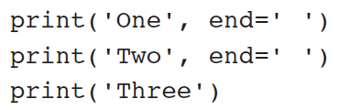
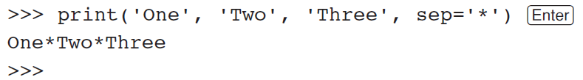
More About Data Output
print function displays line of output
Newline character at end of printed data
Special argument end='delimiter' causes print to place delimiter at end of data instead of newline character
Ex:
print function uses space as item separator
Special argument sep='delimiter' causes print to use delimiter as item separator
Ex:
Notes:
First example output: One Two Three

Slide 30
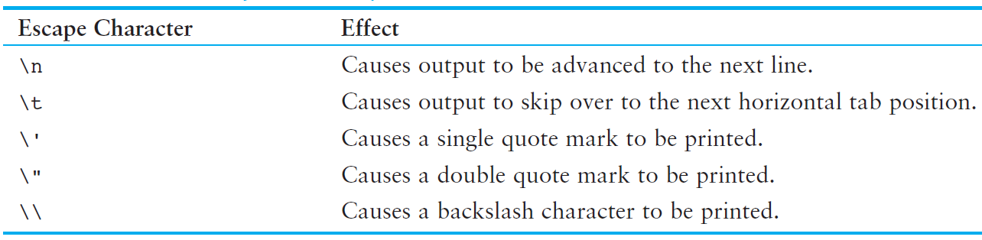

Escape Characters
Special characters appearing in string literal
Preceded by backslash (\)
Ex:
Notes:
Treated as commands embedded in string

Slide 31


Formatting Numbers
Can format display of numbers on screen using built-in format function
Two arguments:
Numeric value to be formatted
Format specifier – includes precision and data type
Returns string containing formatted number
Example 1:
Example 2:
Notes:
The .2 specifies the precision. It indicates that we want to round the number to two decimal places.
The f specifies that the data type of the number we are formatting is a floating-point number.

Slide 32


Formatting Numbers (cont’d.)
The % symbol can be used in the format string of format function to format number as percentage
Ex:
To format an integer using format function:
Use d as the type designator
Do not specify precision
Ex:
Notes:
Can still use format function to set field width or comma separator when formatting integer

Slide 33
Magic Numbers
Magic number: an unexplained numeric value that appears in a program’s code
Example: amount = balance * 0.069
What is the value 0.069? An interest rate? A fee percentage?
Difficult to determine the purpose of the number
Notes:
If the magic number is used in multiple places in the program, it can take a lot of effort to change the number in each location, should the need arise. You take the risk of making a mistake each time you type the magic number in the program’s code. For example, suppose you intend to type 0.069, but you accidentally type .0069. This mistake will cause mathematical errors that can be difficult to find.

Slide 34
Named Constants
Use named constants instead of magic numbers
Named constant: a name that represents a value that does not change during the program's execution
Example: INTEREST_RATE = 0.069
This creates a named constant named INTEREST_RATE, assigned the value 0.069. It can be used instead of the magic number: amount = balance * INTEREST_RATE
Notes:
Advantages of using named constants:
Named constants make code self-explanatory (self-documenting)
Named constants make code easier to maintain (change the value assigned to the constant, and the new value takes effect everywhere the constant is used)
Named constants help prevent typographical errors that are common when using magic numbers

Slide 35
Summary
This chapter covered:
The program development cycle, tools for program design, and the design process
Ways in which programs can receive input, particularly from the keyboard
Ways in which programs can present and format output
Use of comments in programs
Uses of variables and named constants
Tools for performing calculations in programs

Slide 36
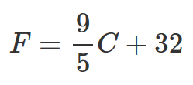
In-class Exercise 1
Write a program that converts Celsius temperatures to Fahrenheit temperatures. The formula is as follows:
The program should ask the user to enter a temperature in Celsius, then display the temperature converted to Fahrenheit.
Make sure you comment your code and include your name, class, lab number, and a brief description of the program as comments at the beginning of your program.
Notes:
First, make students design the flowchart for this program and go over it before telling them to attempt to code it.

Slide 37




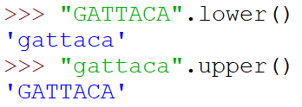
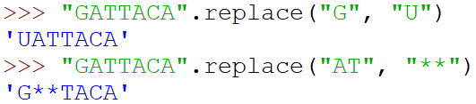
Manipulating Strings – Basics
String Method | Example
Concatenation
Length
Substring test
Substring count
Changing case
Replacement

